Slide 1
Spanning the Competition: An optimisation story
Optimisation for shits and giggles
Notes:
Introduce – DT, Solutions Architect, doing dev for 32 years, started with a ZX Spectrum, moved on to Amiga, C++ and been doing dotnet since .NET Framework 2
I really like understanding the low level aspects and eeking out as much perf as possible
Little piece of background, I did sales for many years before doing development commercially, so I’m quite competitive!
In keeping with the current thing, all images in this presentation are AI generated using Midjourney
I’ll be talking today about optimisation, the PG title …. But it’s what I like to call

Slide 2

Premise
We’re moving from ASP.NET MVC to Vue.js with a .NET back end
We have to do multifactor auth
We need to know the user IS our client before we let them in
We need a method that will take a mobile number and mask it
Cant send this to the front end as an API call to the front end without exposing the mobile number to the clients browser

Slide 3

Caveats
There was really no need to do what we did here
Just two senior devs trying to out do each other
It’s probably not the best solution to the actual problem

Slide 4

So you like to optimise huh?
Measuring performance before optimising is key to understanding whether you should be focusing on this code or looking elsewhere.
The data collected from performance measurements as you make changes give you feedback on the optimisations made so you know if they are actually providing any benefit.
Notes:
Before we optimise, always measure
Donald Knuth Programmers waste enormous amounts of time thinking about, or worrying about, the speed of noncritical parts of their programs, and these attempts at efficiency actually have a strong negative impact when debugging and maintenance are considered. We should forget about small efficiencies, say about 97% of the time: premature optimization is the root of all evil. Yet we should not pass up our opportunities in that critical 3%
In this case we measured ego first
They were big

Slide 5

So how can we measure?
Stopwatch
Timers
A clock?
Stopwatch
High Resolution Timers
A clock?

Slide 6


So how can we REALLY measure?
Just import the nuget
Add some attributes
Run
Get carried away with optimisation
Run, repeat

Slide 7
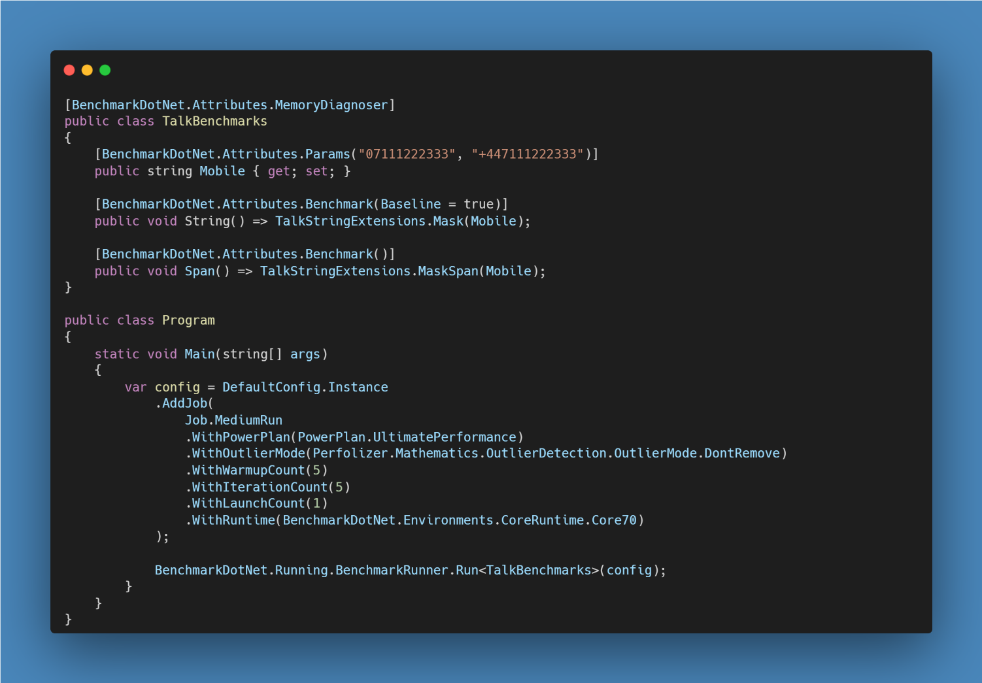

Slide 8
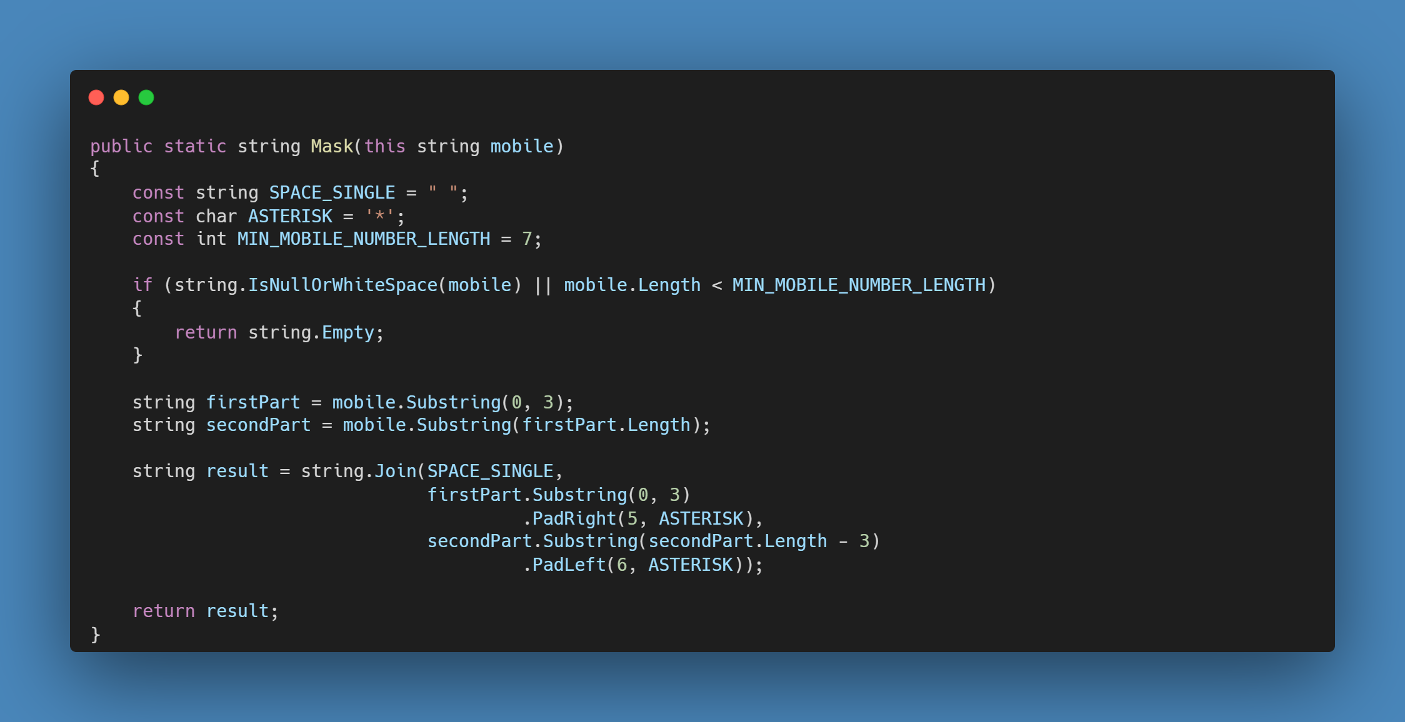
From humble beginnings

Slide 9
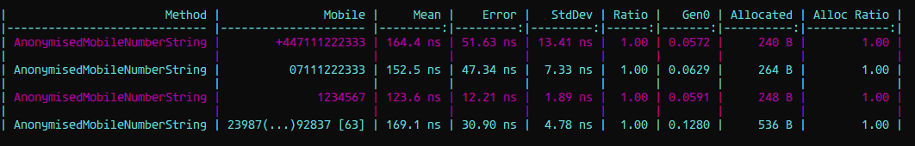
Measuring the baseline

Slide 10
Let’s review
Notes:
Many methods that operate on a string cause an allocation
They have to create a new string to store the result and return that
2) This one is where exacerbates larger allocations as the string does Allocate, allocate, allocate
So what can we do about all of these?

Slide 11
Heap
The heap is a region of memory used for dynamic memory allocation in a program, managed by the garbage collector (GC) in .NET.
So that the GC can manage the heap, the runtime keeps track of the object's lifetime. This allows it to identify objects that are no longer reachable by the program and frees up their memory.
The GC runs periodically in the background, scanning the heap to identify objects that are no longer in use. When an object is found to be no longer reachable, its memory is marked as free and can be reused for future allocations.
This is not a trivial process and can be a performance bottleneck, so we should avoid creating unnecessary objects that will need to be garbage collected later.
Notes:
Region of memory used for dynamic allocation (i.e new keyword)
Managed by GC
Supported by the runtime, keeps track and GC frees when not in use
This is expensive, causes other threads to be suspended, with great power comes great responsibility!
Gen 0, 1, 2 (also Large object heap)
Fundamentals of garbage collection | Microsoft Learn

Slide 12

ReadOnlySpan<T>
ReadOnlySpan<T> is a lightweight struct that represents a read-only sequence of memory. It's useful for scenarios where you want to read the contents of memory without making a copy of it, and where you want to ensure that it can't be modified.
So, to summarize: ReadOnlySpan<T> is like a window into a piece of memory in a glass box. It allows you to view the memory, but not modify it.
Notes:
ReadOnlySpan<T> is like a window into the memory inside the glass box. It allows you to see the contents of the memory, but it doesn't give you the ability to change it. So you can see the memory inside the glass box, but you can't touch it to alter it in any way.

Slide 13
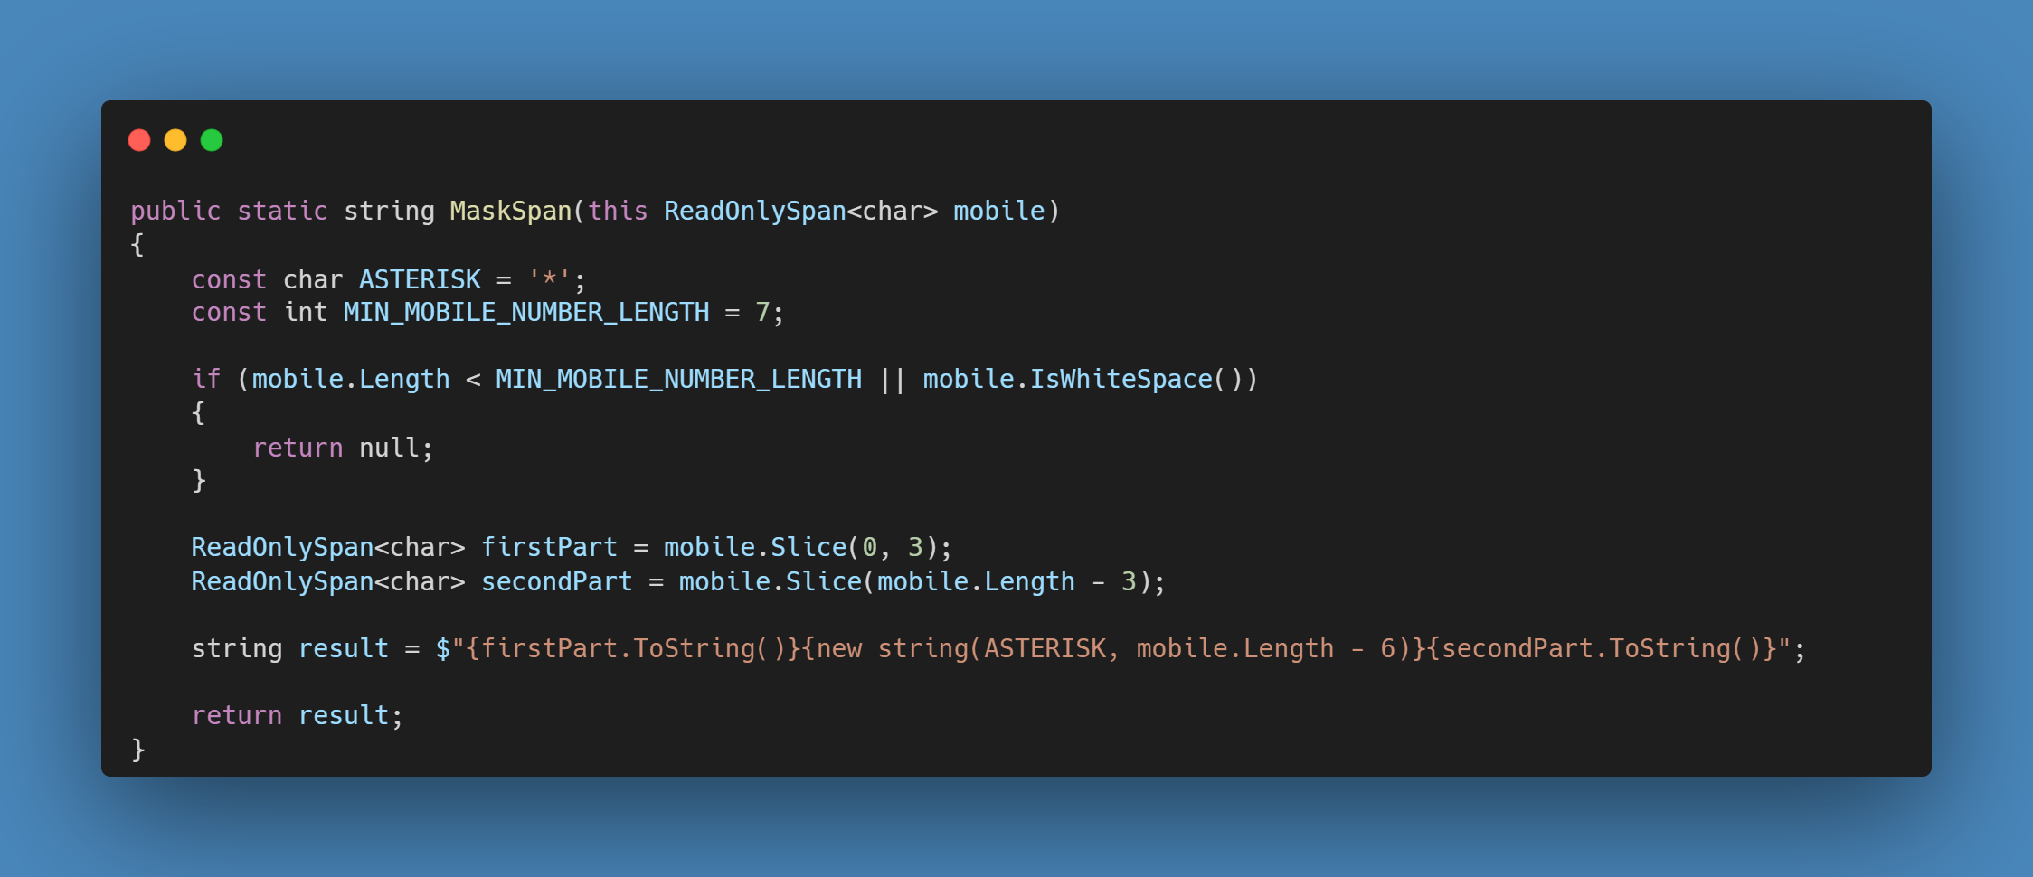
Round 1…fight
Notes:
1) Strings are implicitly convertible to a ReadOnlySpan<char>
We’ve now with a really simple change got a window into the memory of the string
2) So this window isn’t a fixed window, we can slice and dice it – which really handily, is like a substring!
3) Better, but – we’ve still got some allocations

Slide 14
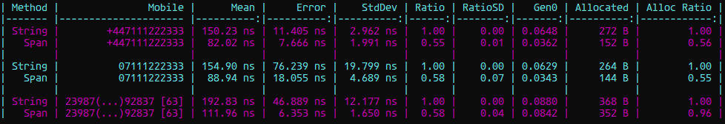

Slide 15
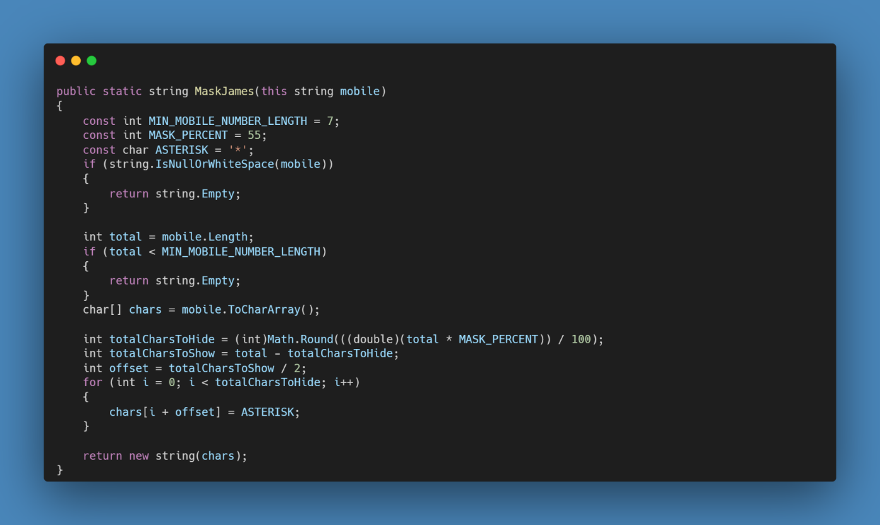
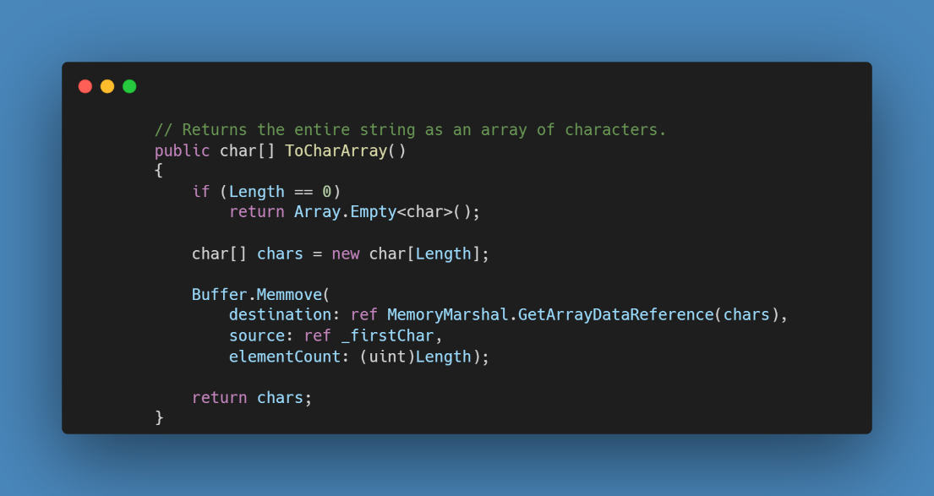
Enter the dragon
Notes:
So James swoops in with this method
1) We have some scope creep here, but we’re going to roll with it and we can have some more fun with optimisations
Nice, this removes a lot of allocations
Great idea iterate over the characters and replace
Why does this work? Because essentially a string is just an array of char’s
2) But, ToCharArray allocates
5) He’s adding the offset in each iteration The runtime also checking this isn’t out of bounds each time – more on that later
This is going to be crap, there’s no way this performs

Slide 16
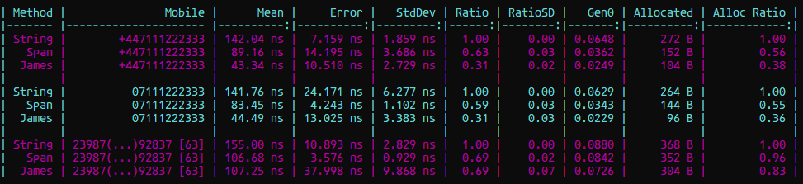
Notes:
Oh, it’s..faster…and it allocates less
Right, I have to beat this now. I can’t let him win!
Time to bring out the big guns

Slide 17

stackalloc
It's important to note that stackalloc has some limitations. The amount of memory that can be allocated with stackalloc is limited, and the memory is automatically deallocated when the method containing the allocation exits. This means that you need to be careful when using stackalloc to avoid running into issues with stack overflow or unintentional memory deallocation.
In .NET, the default stack size for a thread is 1 MB for 32 bit processes or 4MB for 64 bit processes, which means that the maximum amount of memory that can be allocated on the stack is 1 MB minus the amount of stack space used by the function.

Slide 18
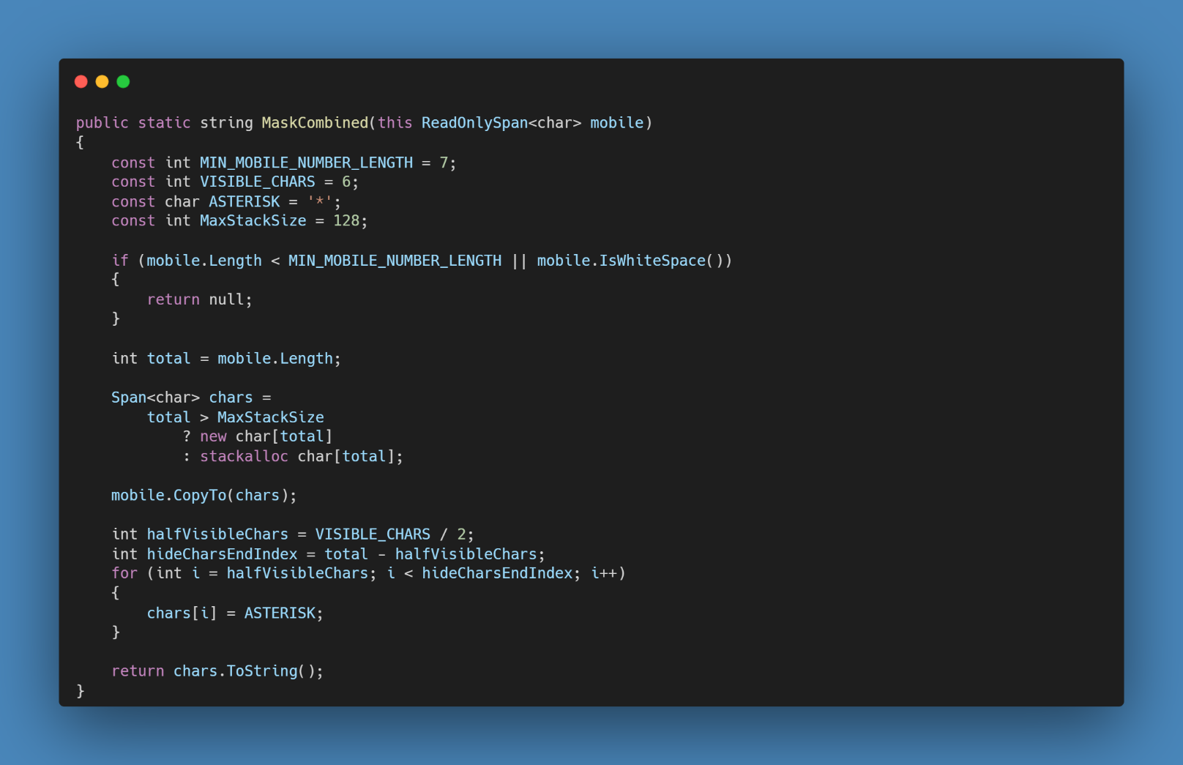
Powers combine^
Notes:
Calculate the offset outside of the loop
And use it to initialise the index

Slide 19
Powers combine^
Notes:
Calculate the offset outside of the loop
And use it to initialise the index
Now we just have one heap allocation

Slide 20
Stack
The stack is a region of memory used for storing temporary data, managed by the operating system and deallocated automatically when the method exits. The runtime allocates memory on the stack for the object or data structure to be created. Stack memory does not need to be managed by the GC.
This makes the stack a faster and more efficient option for small, short-lived memory allocations that do not require the advanced memory management features provided by the heap and the garbage collector.
Stack memory is typically limited in size and is not as flexible as heap memory. If too much memory is allocated on the stack, it can cause a stack overflow error.
Notes:
https://stackoverflow.com/questions/28656872/why-is-stack-size-in-c-sharp-exactly-1-mb

Slide 21

Span<T>
To continue the glass box analogy, Span<T> is like the act of smashing the glass of the box to gain direct access to the memory. It provides a view into a block of memory, just like ReadOnlySpan<T>, but it also allows you to modify the values directly.
Span<T> is a lightweight struct that represents a writable sequence of memory. It can be used to modify memory, without copying it. This can be useful for scenarios where you need to modify the values in place, or where you want to avoid the overhead of copying large amounts of data.
Notes:
Span<T> is like smashing the glass on a ReadOnlySpan<T>.
It’s a struct representing the memory, which allows you to modify it without copying, which is great for optimisation.

Slide 22
Powers combine^
Notes:
stackalloc
Calculate the offset outside of the loop
And use it to initialise the index
Now we just have one heap allocation

Slide 23
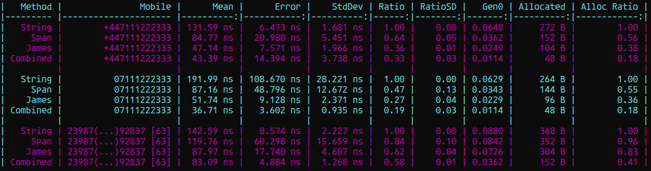

Slide 24
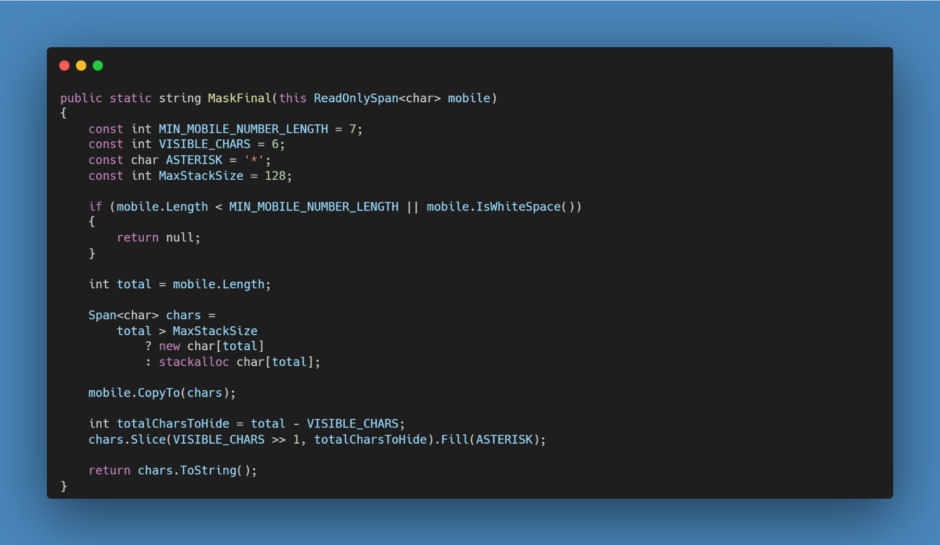
We can do better
Notes:
2) Use bitshift rather than division by powers of 2, shifting once to the right equals / 2 – Saves a small amount of nanoseconds 3) Fill – eliminates need to calculate the end position
3) Fill – Vectorised - Makes use of SIMD (Single instruction, multiple data). So the same instruction is applied to a vector of data (Performance gain increases with size)
A Vector is a contiguous fixed length array containing, integers, floats (sound similar to Span? That is the workhorse for much of the .net improvments)

Slide 25
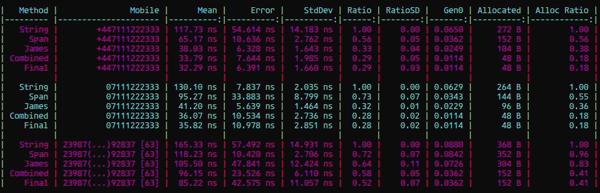

Slide 26
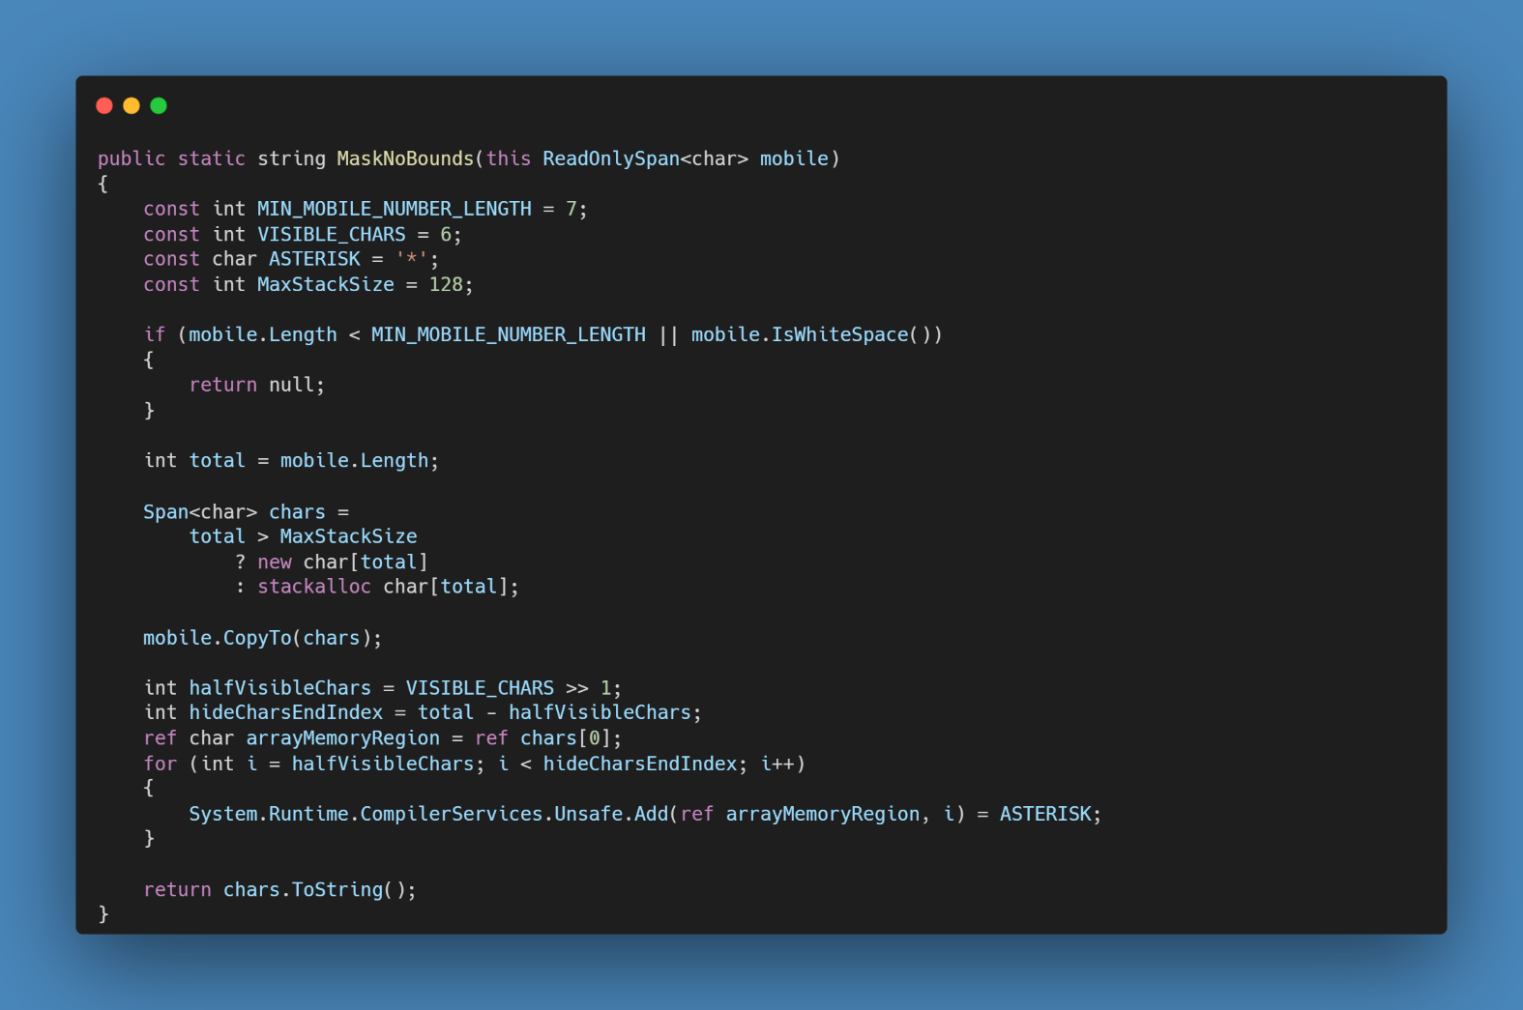
Boundless Performance
Notes:
Managed code automatically checks the bounds of an array when you access. The JIT can eliminate unnecessary range checks from loops. To ensure elimination, explicitly test the array length in the "for" statement. But we can also cheat Writing High-Performance Managed Applications : A Primer | Microsoft Learn

Slide 27
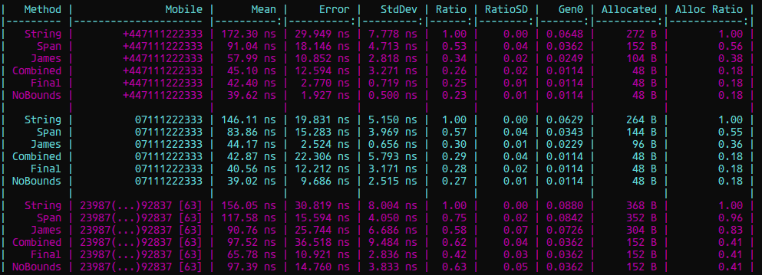

Slide 28
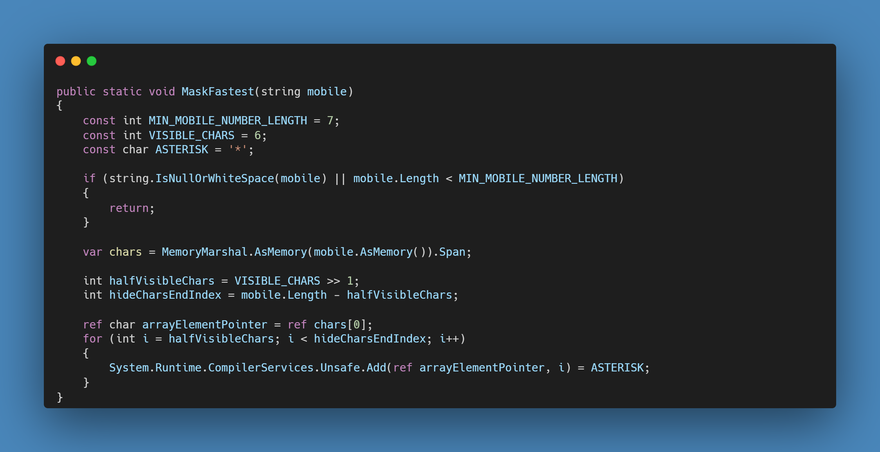

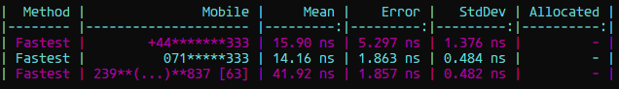
The fastest – and furious
Notes:
Audience: Are strings immutable?
We can convert the string to ReadOnlyMemory<T>
Then cast is a Memory<T>
And now get it’s Span
Then the same dance we’ve just seen with the range checks eliminated
5) So, are strings immutable?
But wait, there’s more

Slide 29
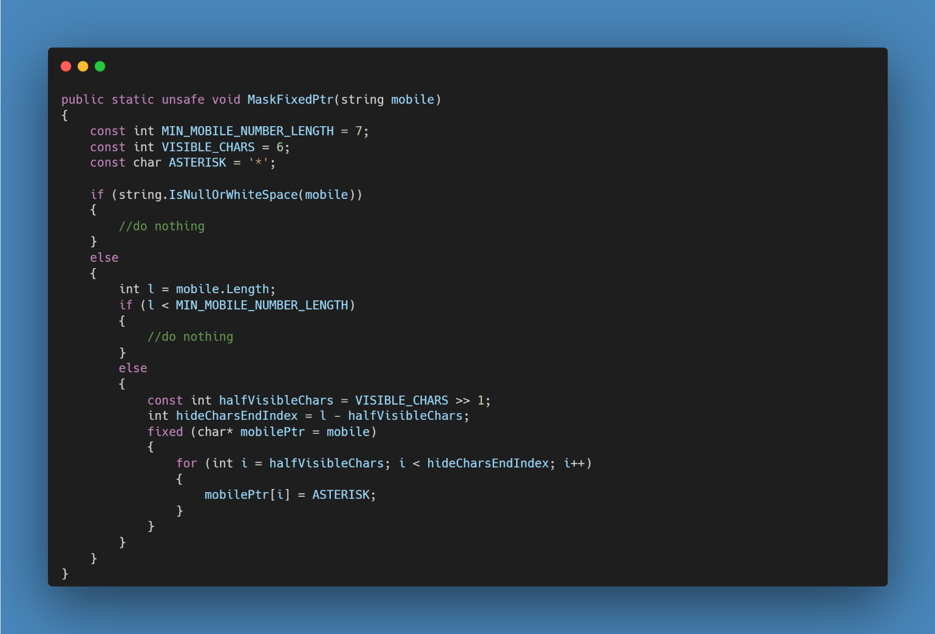
Unsafe speeds!
Notes:
Remove the return statement, one less instruction in the resulting IL
Moves the more expensive virtual method call
Division becomes a constant
Pins a fixed pointer to the character array, similar to the memory marshal but without all of the casts
To use the fixed keyword we have to declare the method as unsafe (and compile as unsafe, VS takes care of adding this flag for you)
Gotcha: The GC understands managed pointers and knows how to update them when it’s compacting the memory. With unsafe this is not true, the managed memory needs to be pinned before it can be used.
Gotcha 2: Using fixed locals prevent methods from inlining.

Slide 30
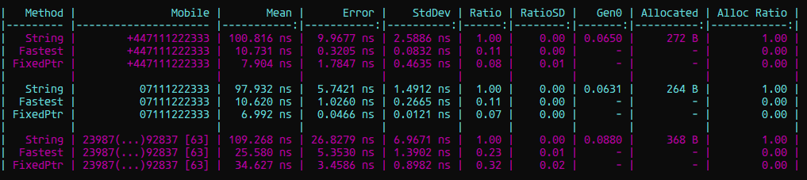

Slide 31
The End
Thanks for listening
Keep an eye on https://github.com/Pepsi1x1 for the code and slides

